Slide 1


Samuel Siles
5/10/2024

Slide 2

Outline
Executive Summary
Introduction
Methodology
Results
Conclusion
Appendix

Slide 3
Executive Summary
Summary of methodologies
Data collection step
Performed webscraping using BeautifulSoup on Wiki page containing information about SpaceX launching data
Data was collected from SpaceX website using and API for it
Exploratory Data Analysis
Collected data was parsed and cleaned using pandas and numpy libraries
Basic data trends and variable relationships were stablish
Interactive Visualizations
Interactive global graphs were build using Folium library and a Dashboard was build using Plotly
Predictive Analysis
Multiple prediction models were build using (Logistic regression, Support vector machine classification, Decision tree algorithms and K-nearest neighbor
Summary of all results
The results of this work show a clear influence of Booster Version, Payload, Orbit and Launching site on the success rate of the flight

Slide 4
Introduction
Project background and context
Space exploration is become more of popular as time passes
Space exploration is extremely expensive because of the single use of rockets.
It is desired to maximize the reusability of rockets
SpaceX is the pioneer in reusable rocket technology
Problems you want to find answers
Learn from SpaceX findings and build models to help us predict the best outcome that will allow us to reuse rockets for space exploration

Slide 5

Section 1

Slide 6
Methodology
Executive Summary
Data collection methodology:
Data was collected from SpaceX website using and API for it
Performed webscraping using BeautifulSoup on Wiki page containing information about SpaceX launching data
Perform data wrangling
Collected data was parsed and cleaned using pandas and numpy libraries
Perform exploratory data analysis (EDA) using visualization and SQL
Perform interactive visual analytics using Folium and Plotly Dash
Perform predictive analysis using classification models
To build predictive models we use pandas, numpy and sklearn libraries
The data set was loaded into a data frame and into numpy arrays
Data set was divided into train and test sets
Train set was used to train different models (Logistic regression, Support vector machine, Decision tree, and K-Nearest neighbor)
Models were tested and scored using the test data sets

Slide 7
Data Collection – SpaceX API
Create connection
Use request library and SpaceX API to create a connection object
Create pandas dataframe
Get response as Json file
Convert Json file into pandas data frame using Json_normalize()
Use define fuctions and ID values in our data frame to get more specify data from the website using the response object
Select and clean data set
Select columns with desired data
Remove missing values in columns using .replace() fuction np.nan values
Flow Chart:
URL link:
Data_collection_with_SpaceX_API

Slide 8
Data Collection - Scraping
Create connection
Use request library and URL website to create a connection object
Extract data from response
Get all tables from soup object
Find table headers on desired table and create a dictionary keys
Find table rows and table data using tr and td tags and add data into dictionary keys
Use dictionary with data to create a pandas dataframe
Get response as text
Create Beautiful soup object to parse HTML response
Create data frame
Flow chart:
URL link:
Data_collection_with_Webscraping

Slide 9
Data Wrangling
Flow chart:
Load data frame
Load dataframe created on last step using panda read CSV method
Explore data set
Class column has two values 1 for successful landings and 0 for unsuccessful landings
Count the values of different columns using .value_counts() method
Create a landing outcome column called "Class" by using the values in the Oucome column
Save data frame using to_csv() method
URL link:
Data_Wrangling

Slide 10
EDA with Data Visualization
Summarize what charts were plotted and why you used those charts
Scatter plots were used to find the relationship between the different variables
Bar plots were used to compare the effects of values of one column to another column mainly the success landing rate ("Class") column
Line graph was used to compare the success landing rate throughout time
URL Link
EDA_visualization

Slide 11
EDA with SQL
Using bullet point format, summarize the SQL queries you performed
Create data table from pandas dataframe
Identify the number of unique launch sites with select distinct
Identify the first 5 records which Launch site starts with CCA with select and where/like clause
Calculate the total payload launched with NASA (CRS) using select sum(payload) and where clause
Calculate average payload launched with F9V1.1 Booster version using select avg() and where clause
Identify the date of the first successful landing in a ground pad using select min and where clause
List the names of booster versions which have success in drone ship with payloads between 4000 and 6000kg using where/and clause
Calculate the count of mission outcomes using groupby clause
List the names of Booster versions which carried the maximun payload using subquery
List the records which will display the month names, failure landing_outcomes in drone ship ,booster versions, launch_site for the months in year 2015
Rank the count of landing outcomes (such as Failure (drone ship) or Success (ground pad)) between the date 2010-06-04 and 2017-03-20, in descending order
URL Link
EDA with SQL

Slide 12
Build an Interactive Map with Folium
Summarize what map objects such as markers, circles, lines, etc. you created and added to a folium map
Create markers and circles for Launching sites and success rate for each launch
Explain why you added those objects
Because we were trying to identify a relationship with the launch location and the success rate of each launch
Add the GitHub URL of your completed interactive map with Folium map, as an external reference and peer-review purpose
Folium Site location link

Slide 13
Build a Dashboard with Plotly Dash
Summarize what plots/graphs and interactions you have added to a dashboard
Pie chart to quantify the total success rate at different launching sites
Scatter plot to show the relationship between payload and success rate
Dropdown menu was added to sort date for different launching sites
Slider range was added to select the range of payload values to filter data
URL Link
Plotly Dash code

Slide 14
Predictive Analysis (Classification)
Data preparation
Load data into a pandas dataframe
Model training and testing
Use testing data set to test all models
Split data into training and testing data sets
Use training data set to train different models
Model comparison
Logistic regression
SVM
Tree classifier
KNN
Create Grid object
Calculate accuracy score, Jaccard score and plot the confusion matrix for all the models
Tabulate the results and compare
Flow chart:
URL link:
Predictive Analysis

Slide 15
Results
Exploratory data analysis shows clear influence of Booster Version, Payload, Orbit and Launching site on the success rate of the flight
Pie charts show that KSC LC-39A launching site has the highest success count with a success rate of 76.9%
The best booster type to carry loads higher than 2000kg is FT
Tree regression score model has the highest accuracy score of 0.94

Slide 16

Section 2

Slide 17
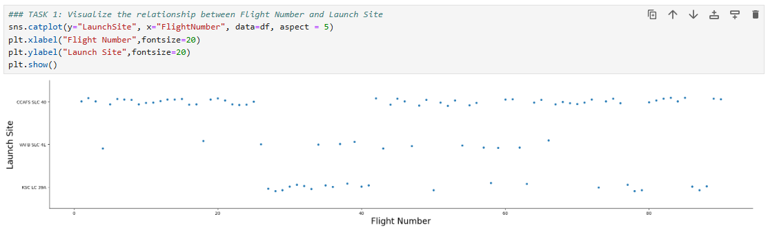
Flight Number vs. Launch Site
Scatter plot of Flight Number vs. Launch Site

Slide 18
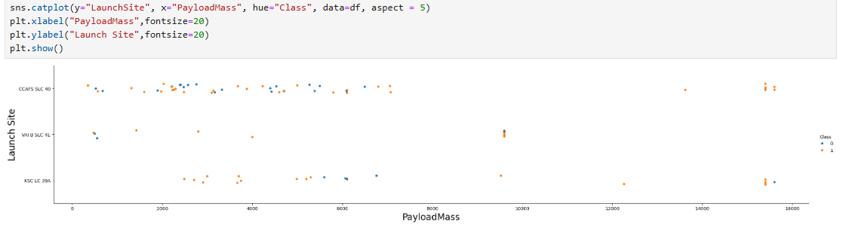
Payload vs. Launch Site
Show a scatter plot of Payload vs. Launch Site

Slide 19
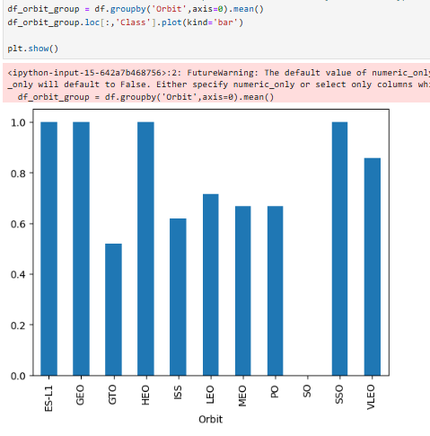
Success Rate vs. Orbit Type
Show a bar chart for the success rate of each orbit type

Slide 20
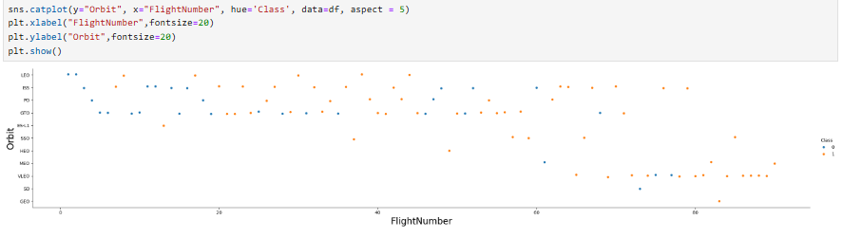
Flight Number vs. Orbit Type
Show a scatter point of Flight number vs. Orbit type

Slide 21
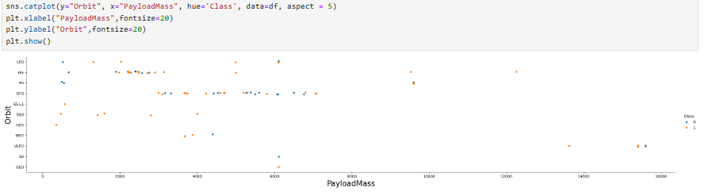
Payload vs. Orbit Type
Show a scatter point of payload vs. orbit type

Slide 22
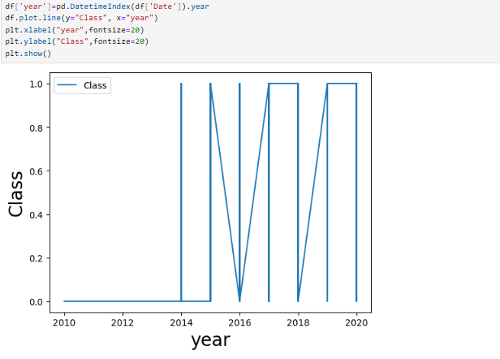
Launch Success Yearly Trend
Show a line chart of yearly average success rate

Slide 23
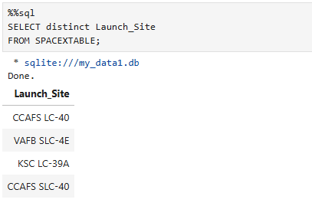
All Launch Site Names
Find the names of the unique launch sites

Slide 24
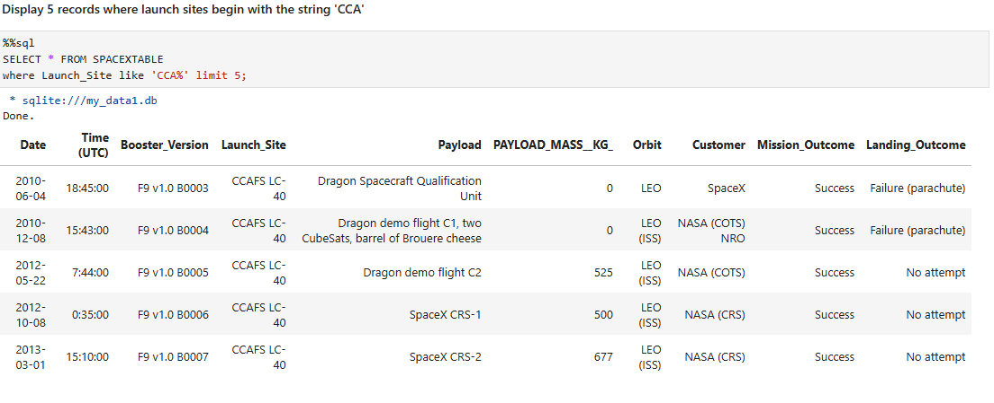
Launch Site Names Begin with 'CCA'
Find 5 records where launch sites begin with `CCA`

Slide 25
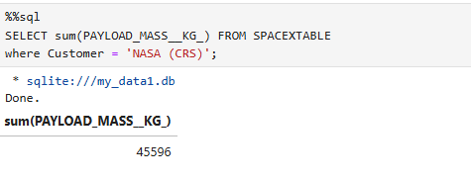
Total Payload Mass
Calculate the total payload carried by boosters from NASA

Slide 26
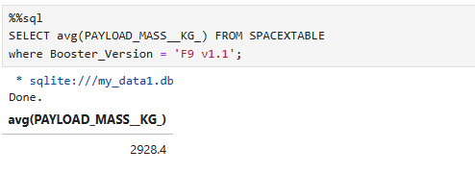
Average Payload Mass by F9 v1.1
Calculate the average payload mass carried by booster version F9 v1.1

Slide 27
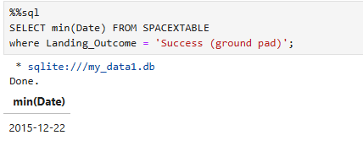
First Successful Ground Landing Date
Find the dates of the first successful landing outcome on ground pad

Slide 28
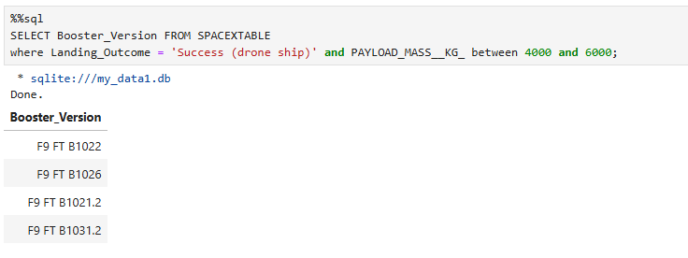
Successful Drone Ship Landing with Payload between 4000 and 6000
List the names of boosters which have successfully landed on drone ship and had payload mass greater than 4000 but less than 6000

Slide 29
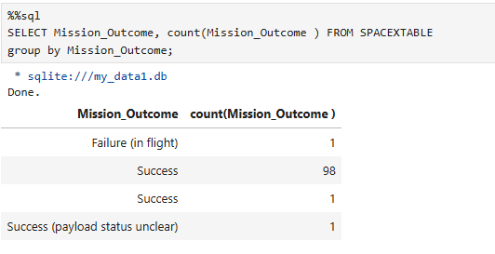
Total Number of Successful and Failure Mission Outcomes
Calculate the total number of successful and failure mission outcomes

Slide 30
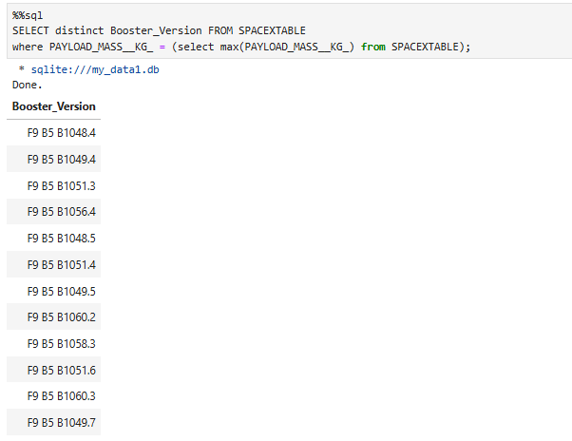
Boosters Carried Maximum Payload
List the names of the booster which have carried the maximum payload mass

Slide 31
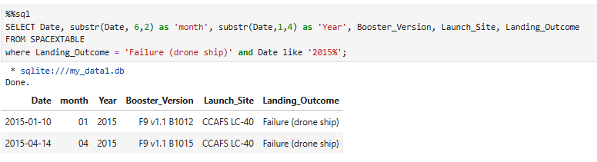
2015 Launch Records
List the failed landing_outcomes in drone ship, their booster versions, and launch site names for in year 2015

Slide 32
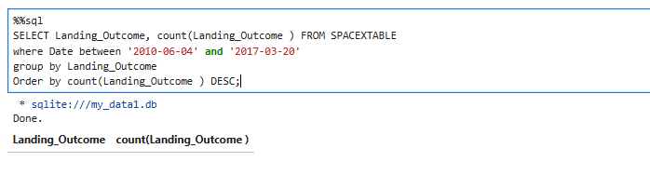
Rank Landing Outcomes Between 2010-06-04 and 2017-03-20
Rank the count of landing outcomes (such as Failure (drone ship) or Success (ground pad)) between the date 2010-06-04 and 2017-03-20, in descending order

Slide 33

Section 3

Slide 34
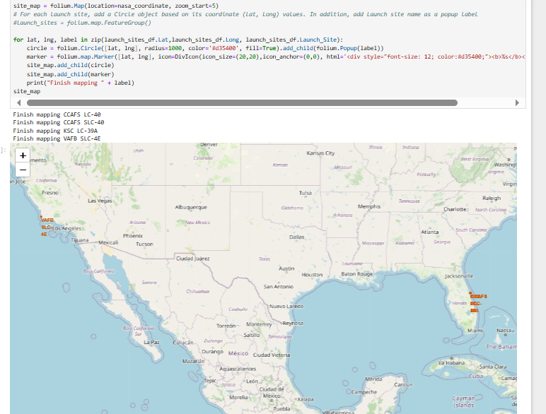
Launch site location map
Map shows the location of the different launching sites showing the geographical differences between them

Slide 35
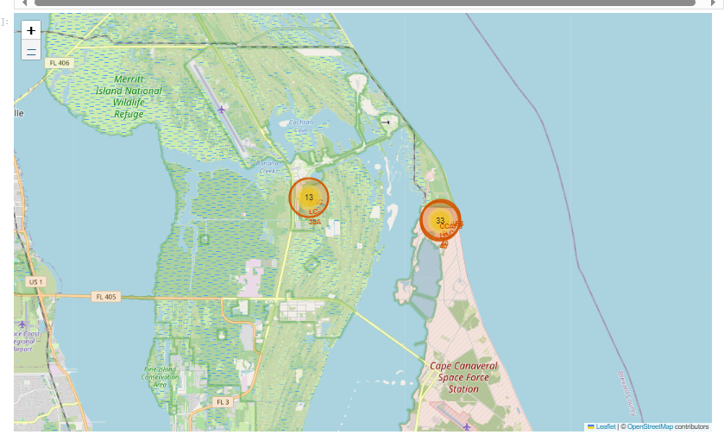
Success rate at different launching sites

Slide 36

Section 4

Slide 37
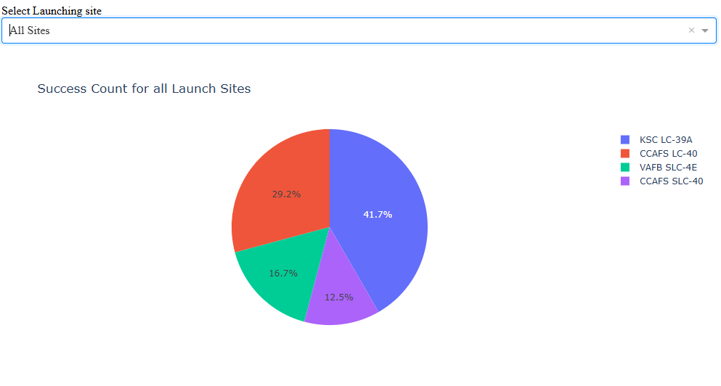
Success Launch for all Sites
Chart shows KSC LC-39A has the highest number of successful launches with 41.7%

Slide 38
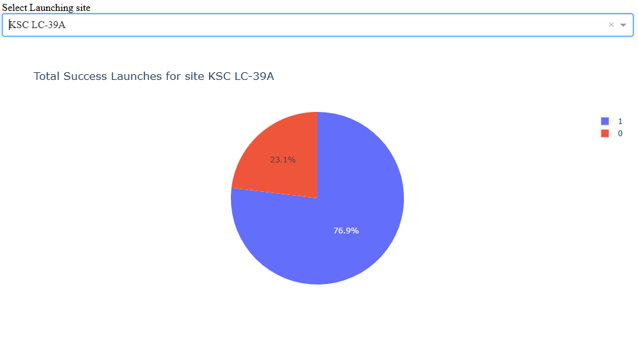
Success ratio for KSC LC-39A launching site
KSC LC-39A launching site has a success ration of 76.9%

Slide 39
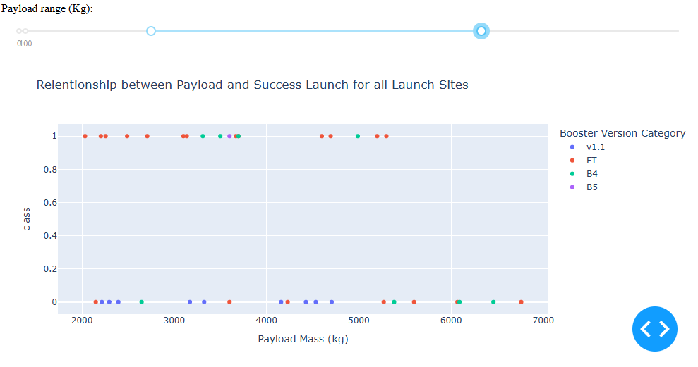
Relationship between payload and Launch outcome for different booster types
For a payload between 2000kg to 7000kg the booster version FT shows the highest success rate

Slide 40

Section 5

Slide 41
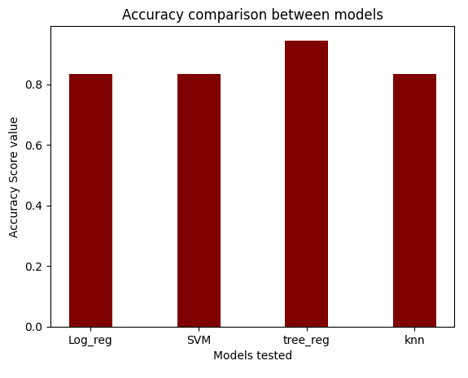
Classification Accuracy
The decision tree classifier model yielded the best accuracy score of 0.94
The other three models yielded the same accuracy of 0.83

Slide 42
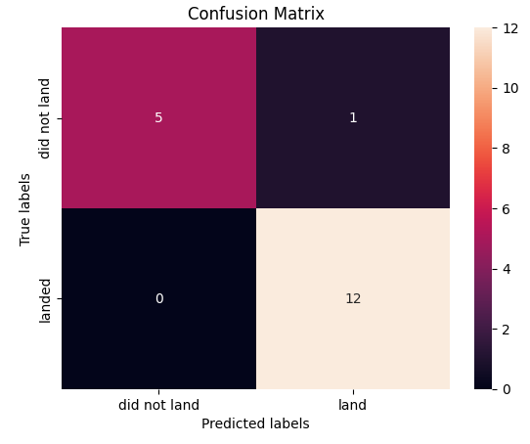
Confusion Matrix of decision tree model
The confusion matrix shows that 12 out of 13 flights that landed were predicted correctly
Also it predicts correctly all the flights that did not land

Slide 43
Conclusions
Data set collected from space x website its wiki site showed that Booster Version, Payload, Orbit and Launching site are significantly affecting the success rate of the landing flight
KSC LC-39A launching site has the highest success count with a success rate of 76.9%
The best Booster version to carry loads heavier than 2000kg is FT
It is possible to predict flight landing success using a Decision Tree classifier model with an accuracy score of 0.94

Slide 44
Appendix
Data_set
SpaceX_Dash

Slide 45


